Slide 1
Project Management
Business Process Reengineering of the Payment process
of
TAPMI Canteen

Slide 2
Current Process & Project Objectives
Current payment process of TAPMI is complex and takes a lot of time
Currently the process takes about a month for completion
Project Objectives
Create a reengineered process that is easy to implement and cost effective
To reduce the time taken by the accounts department to process the payments to the TAPMI Canteen

Slide 3
Expected Business Benefits
Increased efficiency from the usage of a single integrated system
Improve accountability by making single set of data available to everybody
Standardization and automation of processes
Reduction in the paperwork involved and quicker access to data

Slide 4
Key Milestones and Deliverables
Milestones | Deliverables
Kick off | Kick off document
Preliminary analysis and AS IS model | Preliminary Analysis Report containing As Is Diagram
Identification of key process indicators | Process Indicator Document
Identification of IT enablers and IT systems. | IT Requirement document
Re-engineered Model | Reengineered Diagram
Implementation support | User help Documents Lessons Learnt Document

Slide 5
Scope & Success Factors
Project Scope
Success Criteria
Decrease in payment processing time
Reduction in paper usage
Availability of error free, single instance of data to all stakeholders
Includes | Creation of As is process Model and Reengineered Process Model, Identification of Key process indicators, Identification of IT enablers and tools
Excludes | Actual implementation of the Re Engineered Process and training the Users on new process.

Slide 6
Methodology & Project Resources
Analysis of existing processes and identification of pain points
Requirement gathering
Feasibility study
Work Breakdown Structure (WBS)
Budgeting
Development of process flow and Gantt chart
Planning for contingencies
Project Steering Committee | Dr. R. C. Natarajan, Prof. Madhavilatha Nandi.
Sponsor | Dr. R. C. Natarajan
Project Manager | G Abhishek Rao
Project Team Members | Avisek Sarkar, Rutwik Nagwankar, Smiti Chaturvedi, Suraj Thotalu
Other | N/A

Slide 7
Risk Assessment
Project Risks and Assumptions
Constraints & Dependencies
Project Risks | Lack of system acceptance and usage by stakeholders Errors from manual entry of data Completeness and accuracy of data collection
Assumptions | Availability of space for infrastructure No additional costs for training resources No additional manpower required Project will be implemented by third party service provider and the implementation support hours will be billed.
Constraints | The project constraints are the time frame, which is 4 months, and the cost, which is restricted to a maximum of INR. 35,000
Dependencies | The project is dependent on the inputs from the accounts department and TAPMI canteen management.

Slide 8
WBS & Budgeting
Project Duration | 107 Days
Project Cost | INR 30,400
Task Name | Duration
Project Management | 3 days
Requirement Gathering | 3 days
Procurement | 5 days
As Is Model | 32 days
Identification of key process Indicators | 1.5 days
Identification of IT enablers & IT systems | 2.5 days
To Be Model | 20 days
Closure | 4 days
Implementation Support | NA
Important Dates
Project start date : December 23 2015
Project end date : April 7 2015
All resources including the PM is considered to have a constant pay rate of Rs. 200/Day

Slide 9
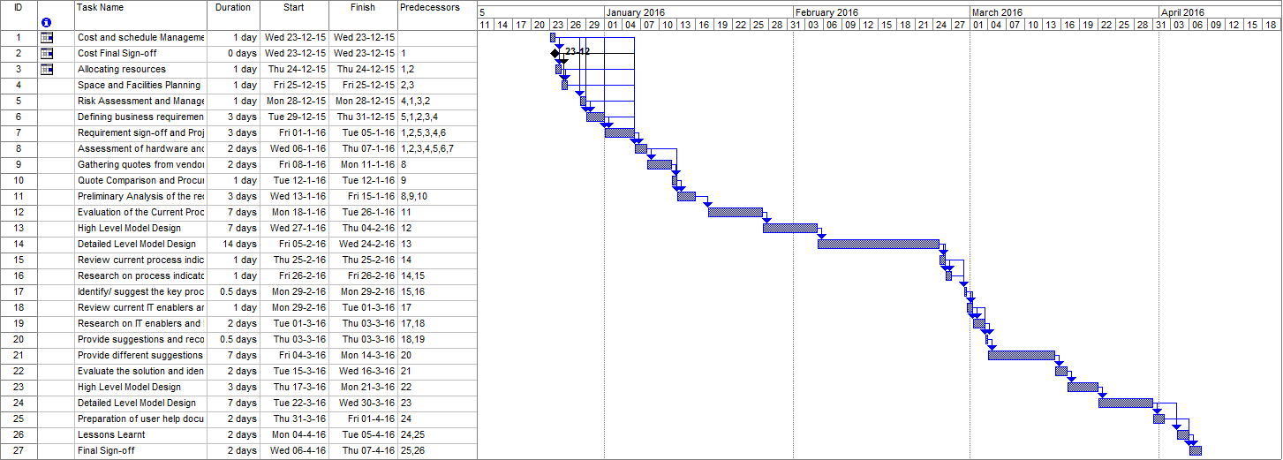
Scheduling

Slide 10


